Slide 1

SQL Server Architecture
Presenter
Nikhil Shah

Slide 2
Brief
SQL Server architecture can be understood by dividing it into three main components: the Protocol Layer, the Relational Engine, and the Storage Engine.
1. Protocol Layer
2. Relational Engine (Query Processor)
3. Storage Engine

Slide 3
Protocol Layer
This layer handles client-server communication. It receives requests from clients and sends back results.
Common protocols include
Shared Memory
TCP/IP
Named Pipes.

Slide 4
Relational Engine (Query Processor)
This component is responsible for processing queries. Its key sub-components are:
Command Parser:
Checks the syntax of the query and creates a query tree (a logical representation of the query).
Query Optimizer:
Analyzes the query tree and determines the most efficient way to execute the query, generating an execution plan. It considers factors like available indexes, table statistics, and estimated costs of different operations.
Query Executor:
Executes the optimized query plan, coordinating with the Storage Engine to retrieve or modify data.
Plan Cache:
Stores previously generated execution plans to avoid re-optimization for frequently executed queries.

Slide 5
Storage Engine
This component manages data storage and retrieval. Its key sub-components are:
Access Methods
Provides an interface between the Relational Engine and the data storage, facilitating operations like data retrieval, insertion, update, and deletion.
Buffer Manager
Manages the data pages in memory (buffer pool) to minimize disk I/O. It retrieves data pages from disk into the buffer pool and writes modified pages back to disk.
Transaction Manager
Ensures data integrity and consistency by handling transactions, including logging changes, managing locks, and ensuring atomicity, consistency, isolation, and durability (ACID properties).
File Manager
Manages the physical database files, including primary data files (.mdf), secondary data files (.ndf), and transaction log files (.ldf).

Slide 6
Simplified Flow of a Query
A client sends a SQL query to the SQL Server via the Protocol Layer.
The Relational Engine's Command Parser validates the syntax and creates a query tree.
The Query Optimizer generates an efficient execution plan, potentially reusing a plan from the Plan Cache.
The Query Executor in the Relational Engine requests data from the Storage Engine.
The Storage Engine's Access Methods retrieve or modify data, utilizing the Buffer Manager and Transaction Manager for efficient and consistent data handling.
The results are then passed back through the Protocol Layer to the client.

Slide 7
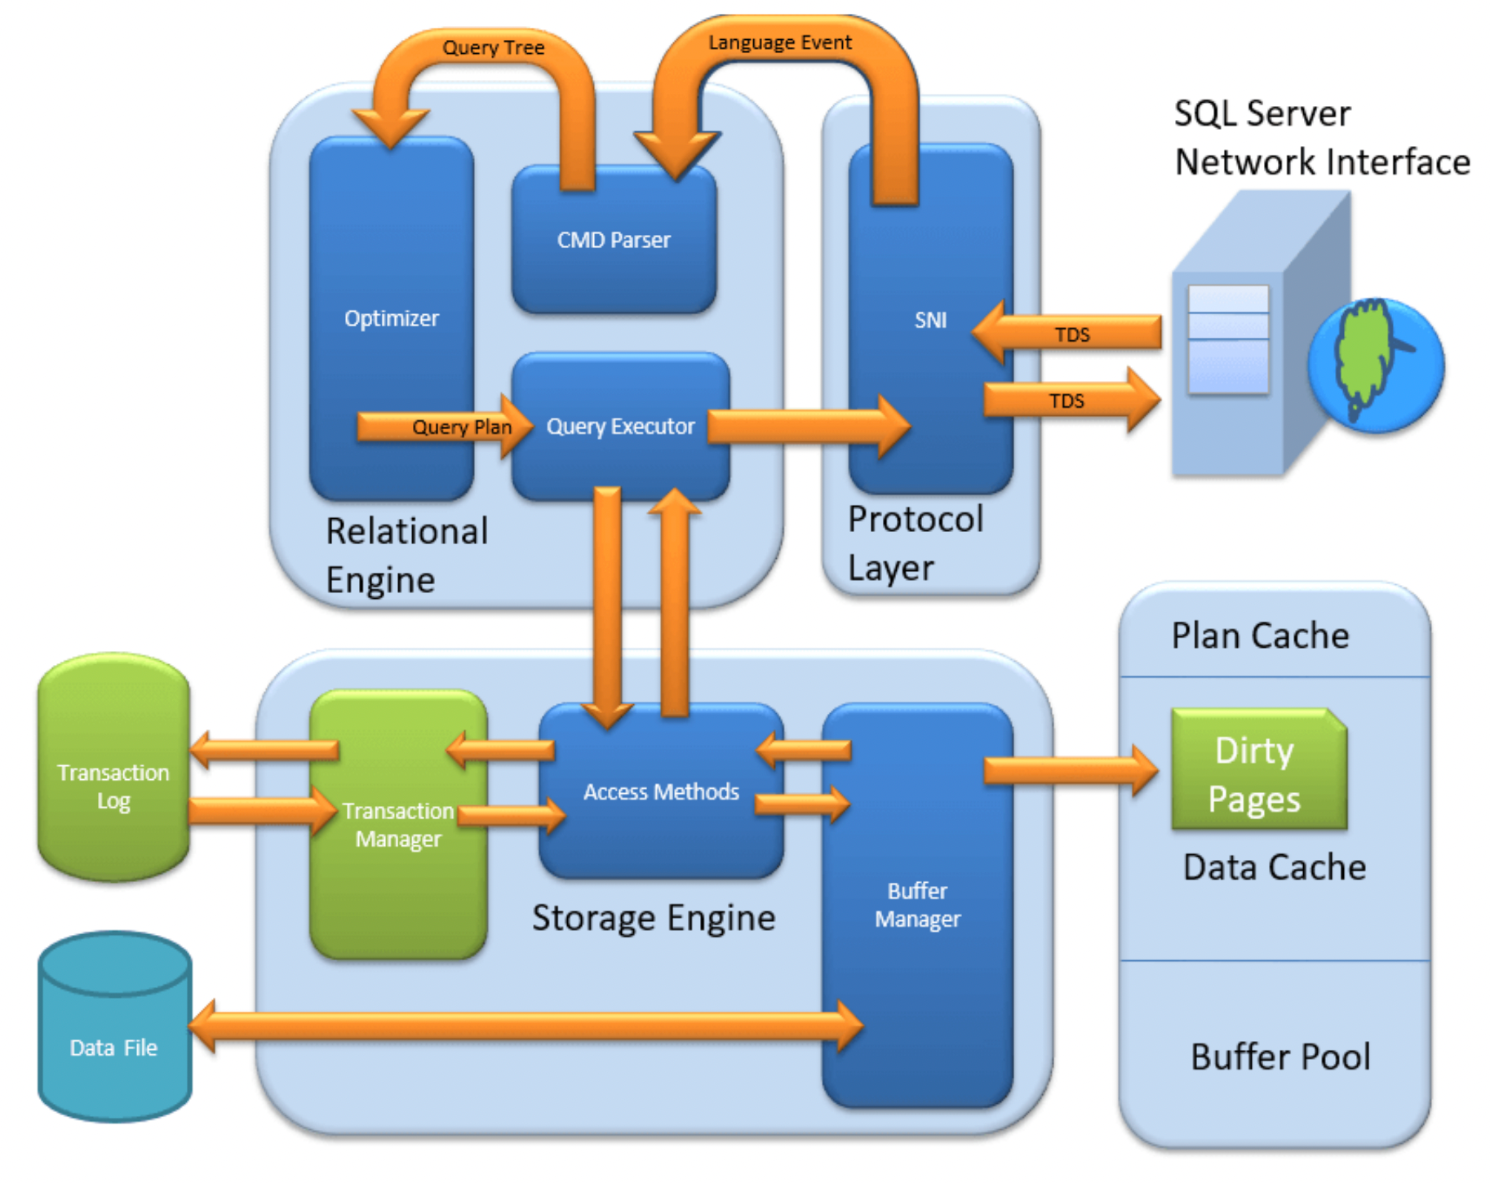

Slide 8
SQL OS
This internal layer, though not always explicitly diagrammed as a separate top-level component, acts as a mini-operating system for SQL Server.
It handles low-level tasks such as
  Thread scheduling
  memory management
  I/O management
acting as an abstraction layer between the SQL Server engine and the actual host operating system

Slide 9

Monitoring & Performance
  Dynamic Management Views (DMVs)
  Wait Statistics
  Query Store
  Performance Monitor (PerfMon)
  Extended Events for diagnostics

Slide 10
SQL Server Health
Memory Health (Buffer Cache, Page Life Expectancy)
I/O Health (Latency, Throughput)
CPU Health (Signal Waits)
Index Fragmentation & Stats
Backup & HA/DR readiness

Slide 11

SQL Server Internals Deep Dive
  Lock Manager & Concurrency
  Transaction Log Internals
  TempDB Architecture
  Columnstore vs Rowstore
  Storage Engine Internals

